Slide 1
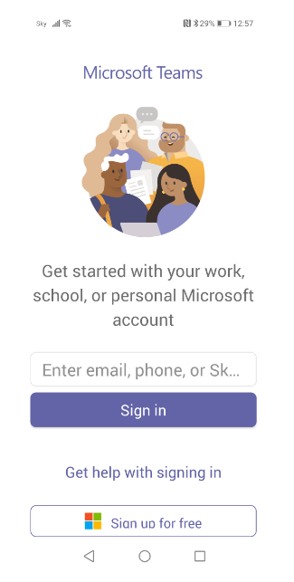
xxxxxx@student.cavc.ac.uk
Click

Slide 2
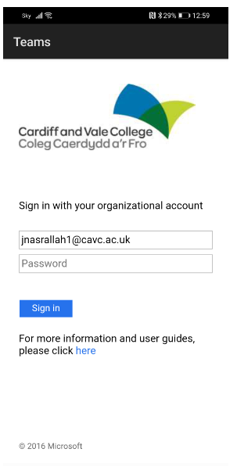
xxxxxx@student.cavc.ac.uk
Enter password
Click

Slide 3
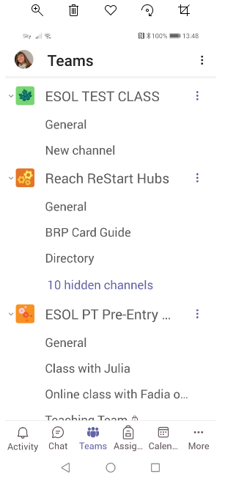
Click on your class
Click on Teams

Slide 4
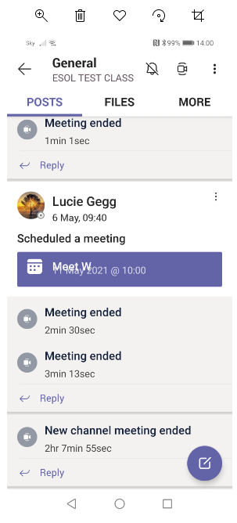
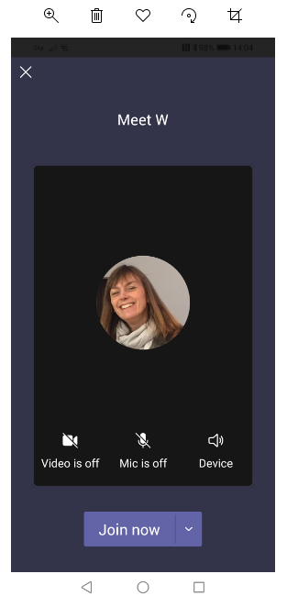
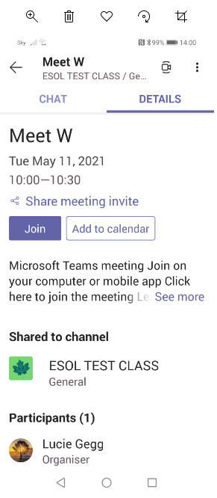
To join a meeting - phone
Click 1
Click 2
Click 3

Slide 5
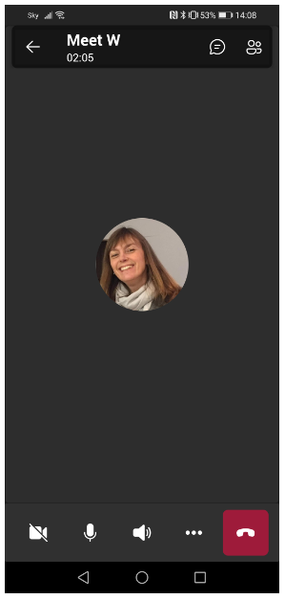
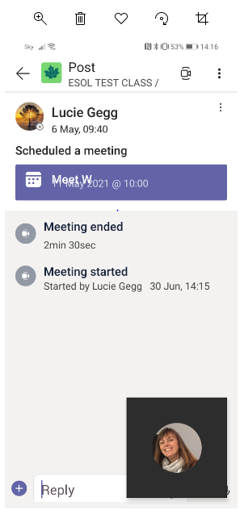
Chat
Mute/unmute
Type
Camera on/off
End call

Slide 6
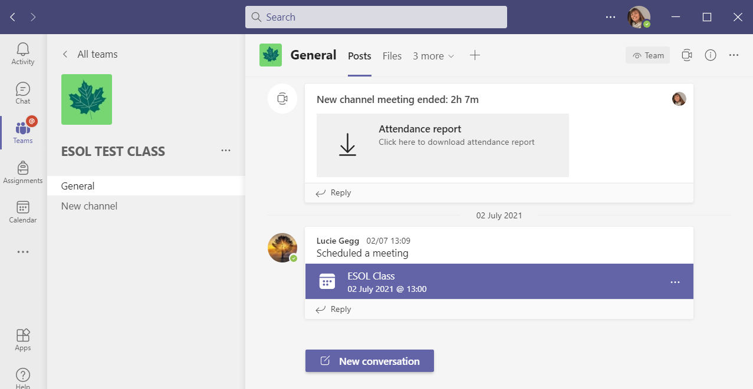
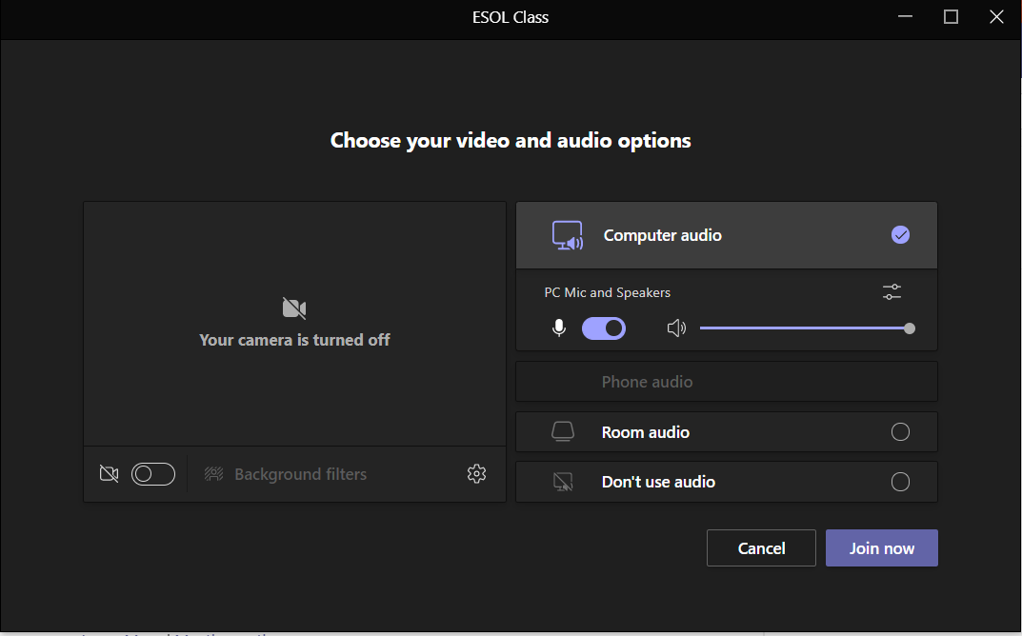
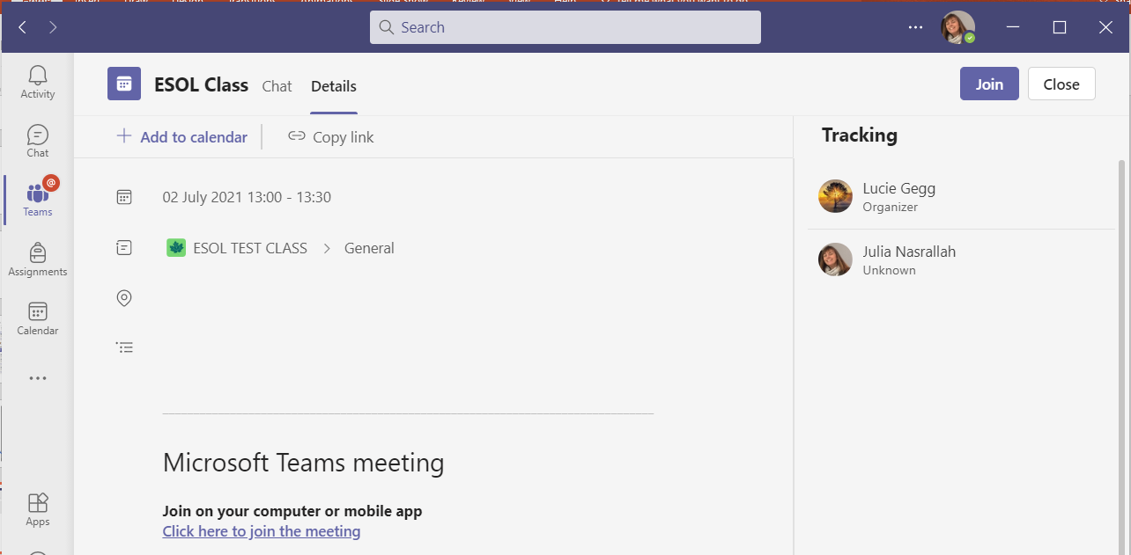
To join a call - laptop
Click 1
Click 2
Click 3

Slide 7
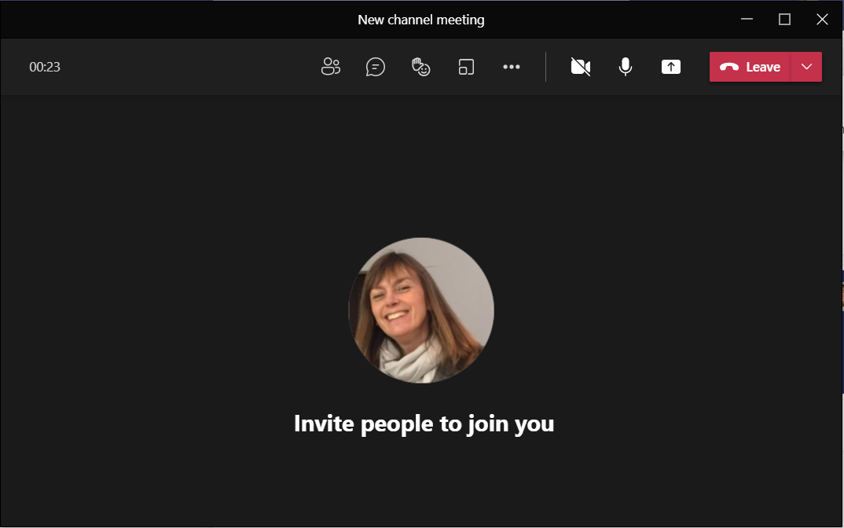
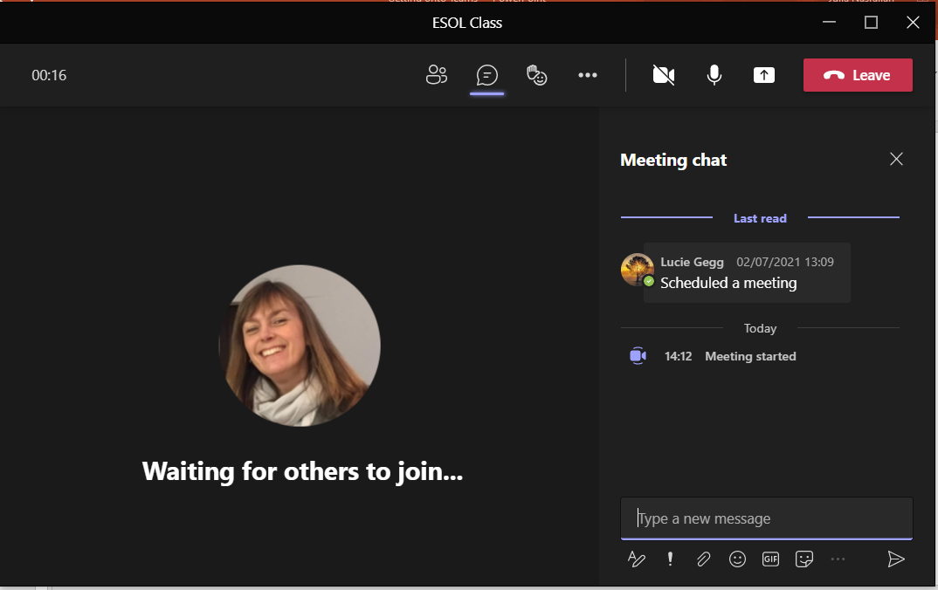
Camera on/off
Chat
Mute/unmute
End call
Type

